Slide 1

Lorain County Erosion & Sediment Control Rules
Caroline Cicerchi
Urban Erosion & Storm water SPECIALIST

Slide 2
Lorain County Erosion & Sediment Control
Background
Plan Types & Best Management Practices (BMPs)
Violations
Resources
Questions

Slide 3

Background
Adopted from Ohio EPA Phase II storm water program of National Pollutant Discharge Elimination System (NPDES)
  NPDES established under the Federal Clean Water Act in 1972; Phase II enacted in 2003.
  Lorain County Board of Commissioners adopted ESC rules in 2009

Slide 4
Purpose
To protect:
landowners from property loss due to sedimentation, erosion, and flooding
County and township ditches, culverts, and storm sewers from loss of capacity due to siltation
Water and habitat quality in streams and wetlands

Slide 5
When do the rules apply?
Soil-disturbing activities on land within unincorporated area of Lorain County used or being developed for Non-farm purposes (commercial, industrial, residential) including:
Individual/multiple lots
Subdivisions
Multiple-family developments
Commercial & industrial developments
Recreational projects
General clearing & grading projects
Underground utilities, highways
Building activities on farms
Notes:
Doesn’t apply to simple maintenance of property. Predominantly NEW construction.

Slide 6
Types of Plans
Key factor: acres of disturbance
Abbreviated Erosion & Sediment Control
Erosion & Sediment Control Plan (ESC)
Comprehensive Storm Water Management Plan (CSWMP)
  Consists of an ESC and Post Construction (PC) plan.
  Also called a Storm Water Pollution Prevention Plan (SWPPP/SWP3)

Slide 7
When to Apply
Application package must be received by Lorain SWCD 30 working days prior to soil disturbing activity.
  Can be mailed into Lorain SWCD office or filled out in person.
Administrator has 21 working days to approve or reject application.
Approved plans remain valid two years from approval date.
Notes:
Check if there are questions

Slide 8
Abbreviated ESC
Most common – Individual lot construction
  Within larger common plan of development – NPDES #
Mostly for disturbances under 1 acre
Does not require formal ESC plan submission
Permit fee of $50
8 main rules/Best Management Practices (BMPs)
Items needed with application:
  $50 check
  ESC application
  Site map
Notes:
NOI Permit number required with submission if under common plan of development!

Slide 9
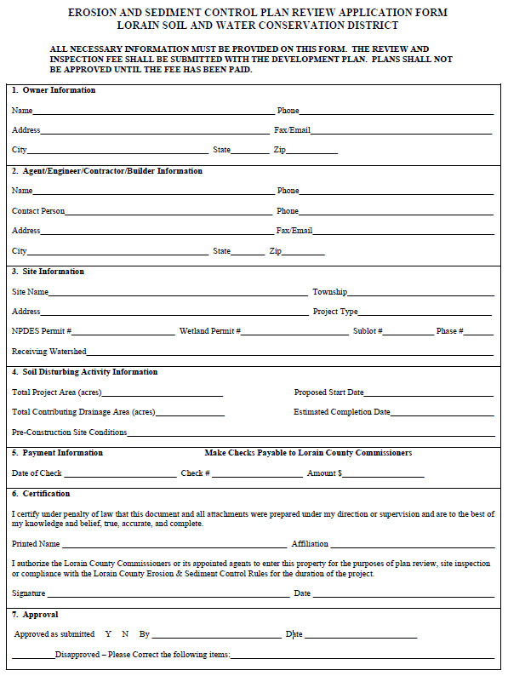
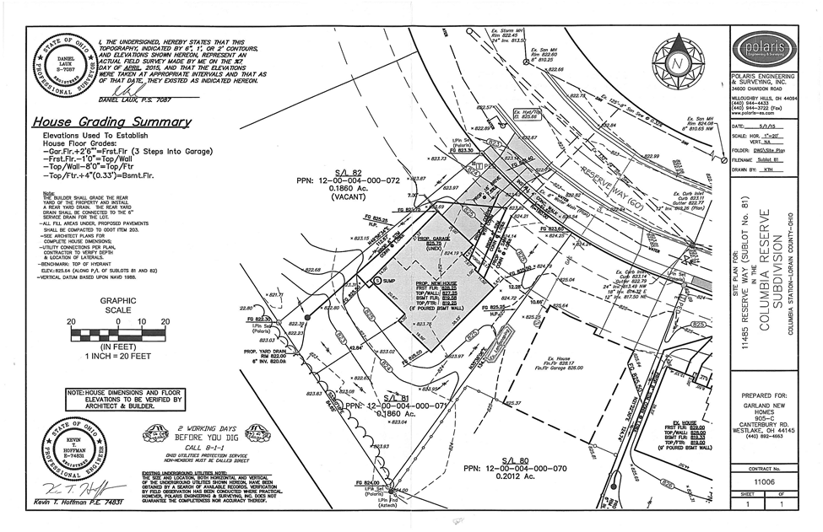
Abbreviated ESC Cont.
PDF of application can be found at
Lorainswcd.com
Under “NPDES – Phase II” tab
Notes:
Helps if you include email address & preference of email vs. mail of letters
More detailed a site map is the better
Try to draw on requirements as well as type up
Key items: structures, limits of disturbance, soil stockpiles, SF, existing vs. proposed grades, and STORM INLETS

Slide 10
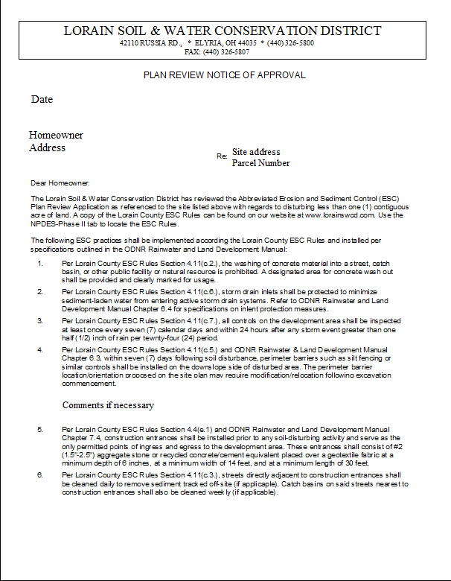
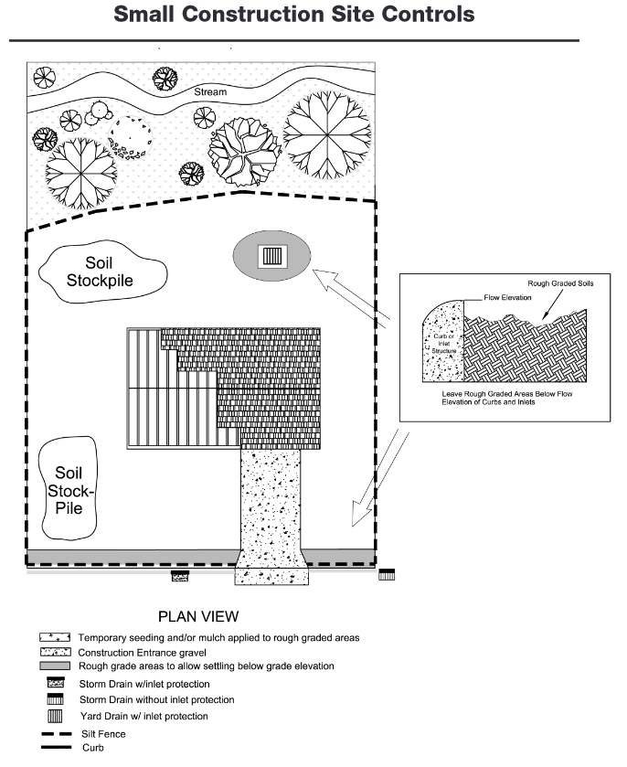
Abbreviated ESC

Slide 11
8 Abbreviated ESC Rules/Management Practices
Silt Fence/Perimeter Barrier
Inlet Protection
Construction Entrances
Concrete Truck Wash Out Area
Street Sweeping
Internal Inspection and Maintenance
Temporary Stabilization
Permanent Stabilization
All controls must be installed within 7 days of grading activity.

Slide 12
Silt Fence/Perimeter Barrier
Intended to pond water long enough for suspended sediment to settle
Place along the down slope of any disturbed areas and along any water resources PRIOR to upslope disturbance.
Acceptable perimeter barriers:
Silt fence
Filter sock

Slide 13
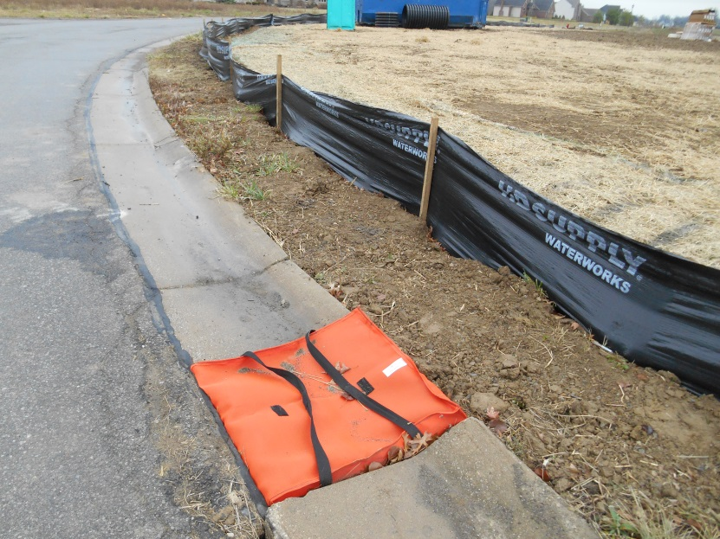
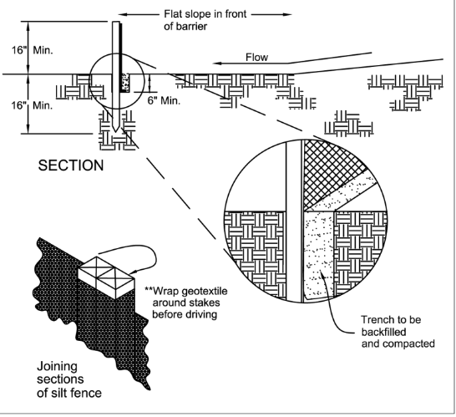
Silt Fence
Must be trenched (6” deep) and backfilled into ground
Must be placed on flattest area available
Ends of fence must be brought upslope
Must use 2” x 2” wood posts every 10 ft. of fence
Seams between sections of fence must be double wrapped
Used for sheet flow
Notes:
Can’t be used for slopes greater than 50% → use sediment settling pond instead

Slide 14
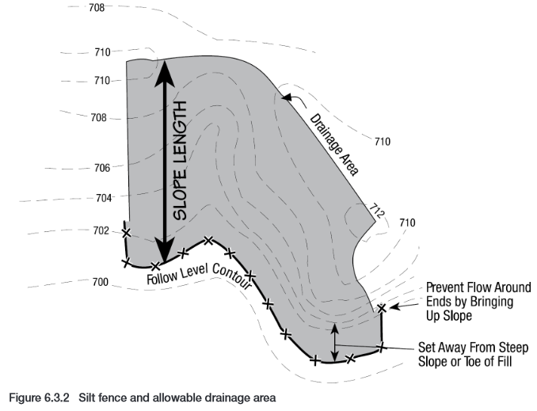
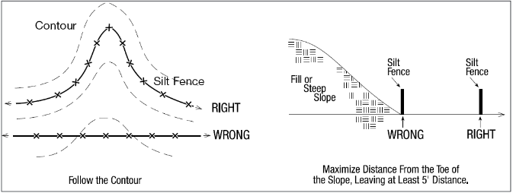
Silt Fence Cont.
Must follow contour of land
Place at toe of slope leaving
at least 5’ distance

Slide 15
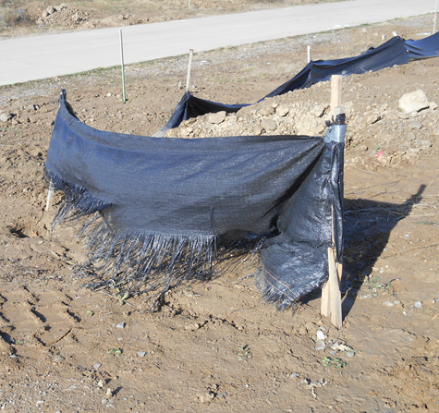
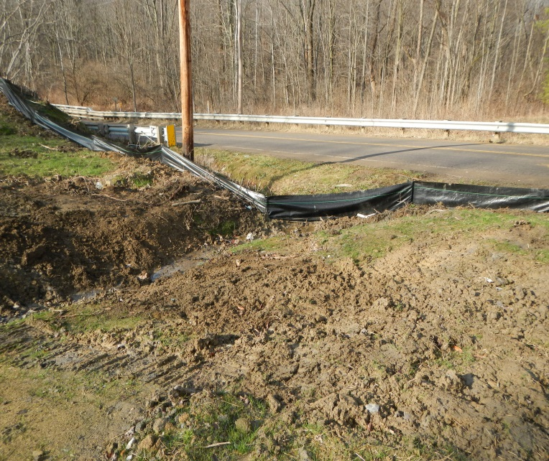
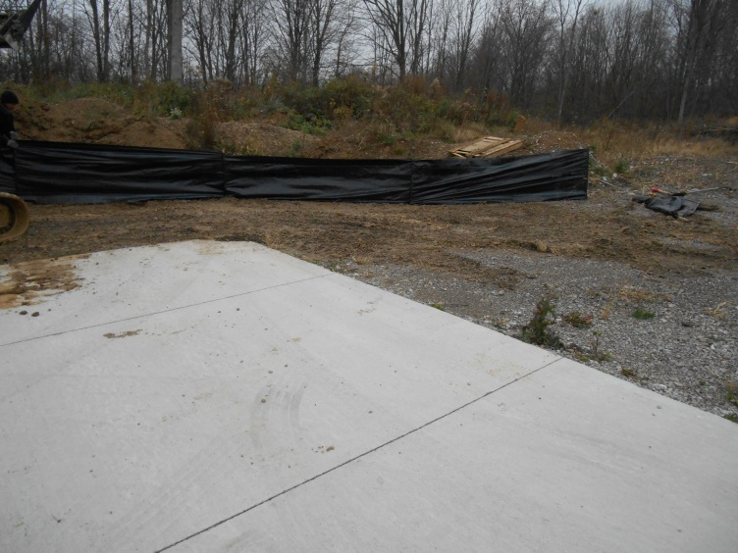
Silt Fence: Common Problems
Not trenched/backfilled
General maintenance
Installed backwards
Knocked down
Notes:
General maintenance neglect. Stakes breaking
Sediment piled over ½ height of fence
Not wrapped upslope
Not trenched and backfilled
Used as concentrated flow instead of sheet flow
Installed backwards

Slide 16
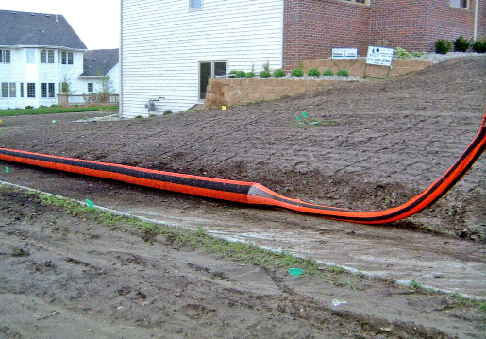
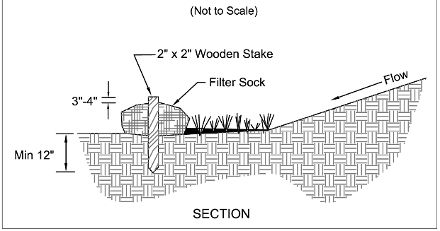
Filter Sock
Perimeter barrier alternative to silt fence
For slopes up to 2:1
Consists of composted material
Place on toe of slopes
Follow contour of land
Staked into ground
Notes:
Benefit – disturbs less ground to install

Slide 17
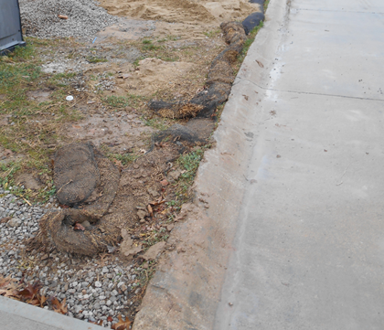
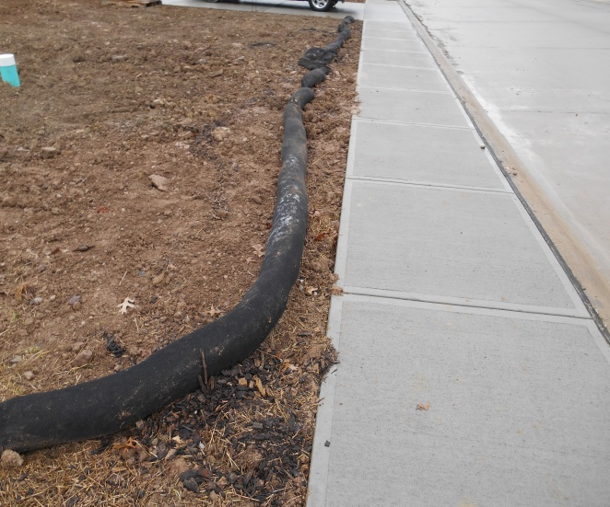
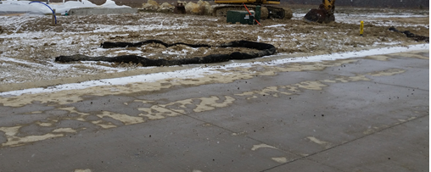
Filter Sock: Common Problems
Not staked into ground
Run over/flattened
Moved out of way
Ripped open

Slide 18
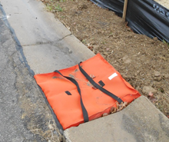
Inlet Protection
Required for all storm drain inlets NOT draining to sediment pond
Must be used in conjunction with other sediment controls
Six approved kinds
Includes:
Yard inlets
Curb inlets
Notes:
Limited capacity to control silts and clays – considered a secondary control
Can pond water on streets – pose hazard
Requires frequent maintenance – sediment build up

Slide 19
Inlet Protection
Six types:
Excavated Drop Inlet Sediment Trap
Geotextile Inlet Protection
Geotextile-Stone Protection
Geotextile-Stone Curb Inlet Protection
Block and Gravel Drop Inlet Protection
Manufactured Inlet Protection Devices

Slide 20
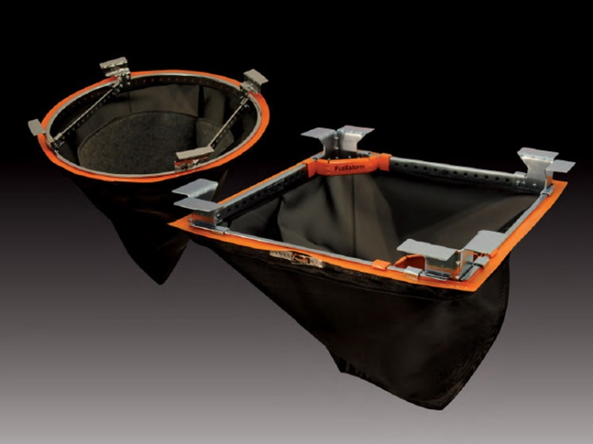
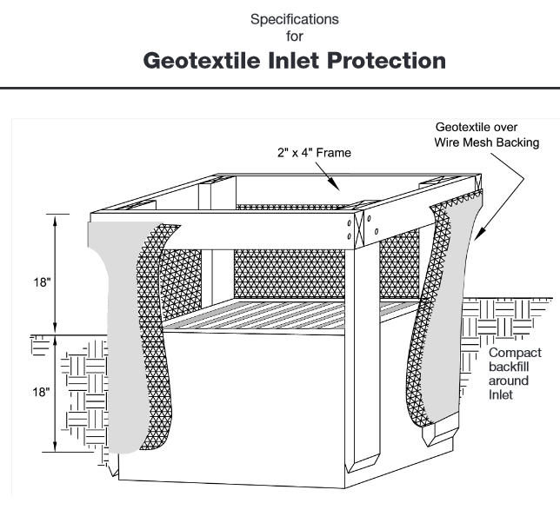
Inlet Protection
Most commonly used:
Manufactured Inlet Protection Devices (curb)
Geotextile Inlet Protection (yard)

Slide 21
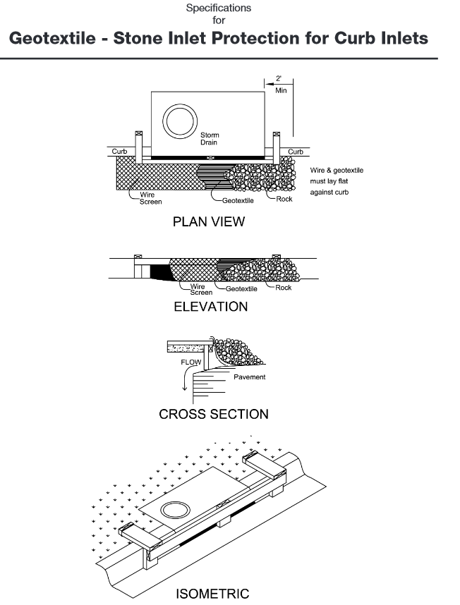
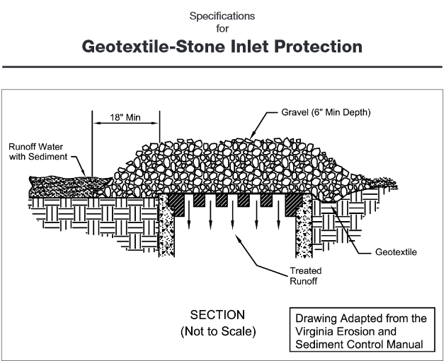
Inlet Protection

Slide 22
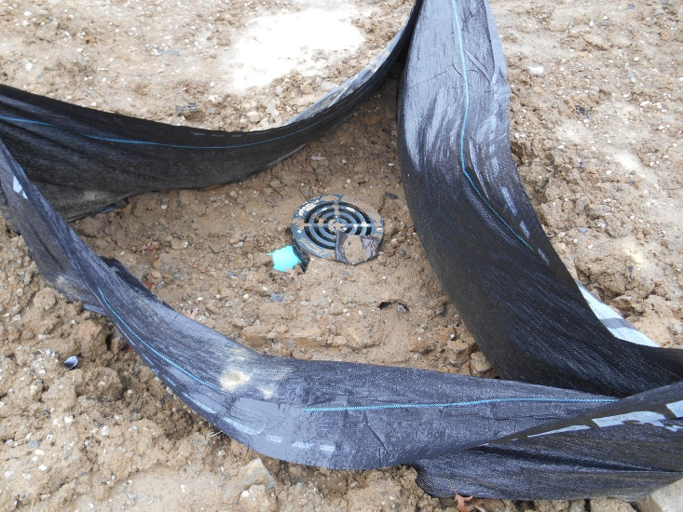
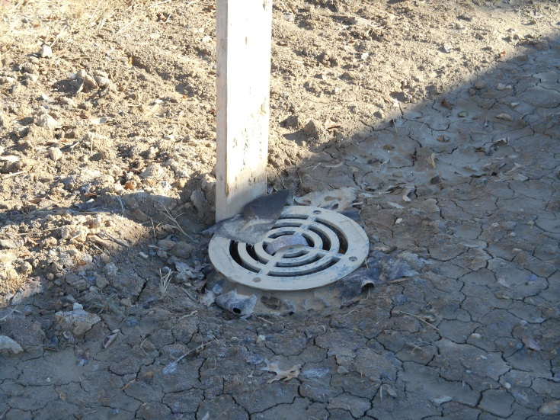
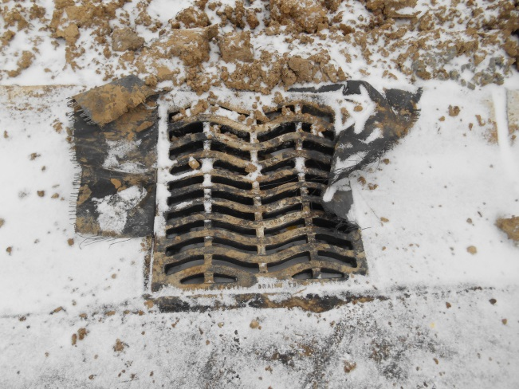
Inlet Protection: Common Problems
Use of geotextile fabric laid under grate
Use of unapproved methods
Notes:
Inlet protection required when you do not have skimmer in a sediment basin.

Slide 23
Construction Entrance
Used to reduce mud tracked off-site
Must be the only point that vehicles enter/exit sites
Must use geotextile fabric on the bottom, and ODOT #2 (1.5-2.5”) stone on top
Minimum Measurements:
- Length
70 ft. (or as long as needed)
30 ft. for single residence lots
Width
14 ft. (or as wide as needed)
Thickness
6-10 in. (Dependent on use)

Slide 24
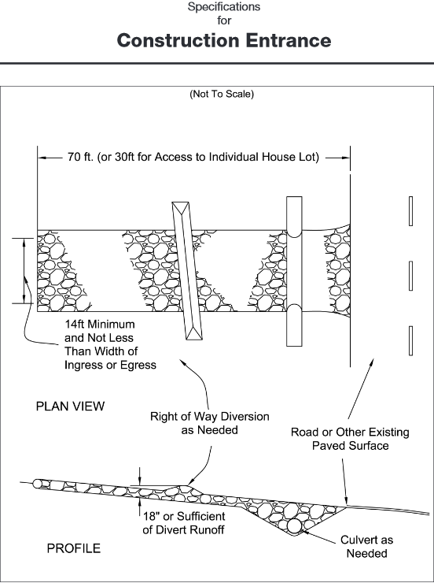
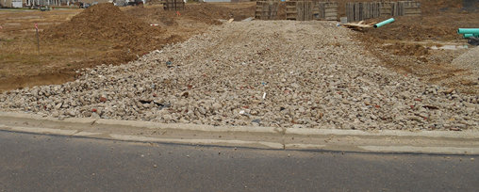
Construction Entrance
Notes:
Water bar/culvert sometimes needed to divert water perpendicularly and prevent runoff from flowing down the construction entrance.

Slide 25
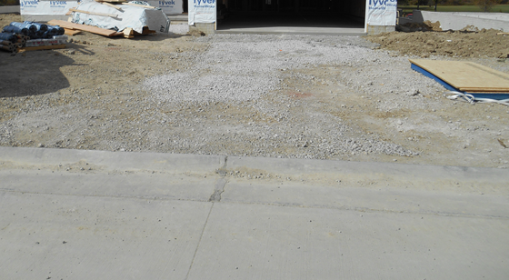
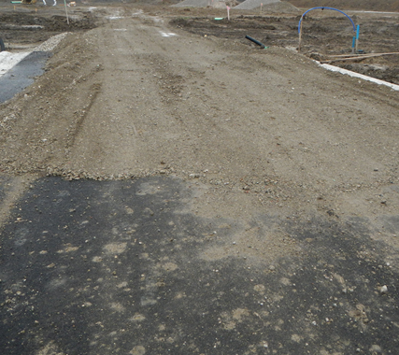
Construction Entrance: Common Problems
No geotextile underneath
Wrong size stone
Not enough stone
Wrong measurements
Notes:
Common compliance problems –
Driving over curbs
Not installing an entrance at all/driving through the mud
If trucks go over corners, entrance must be extended in width

Slide 26
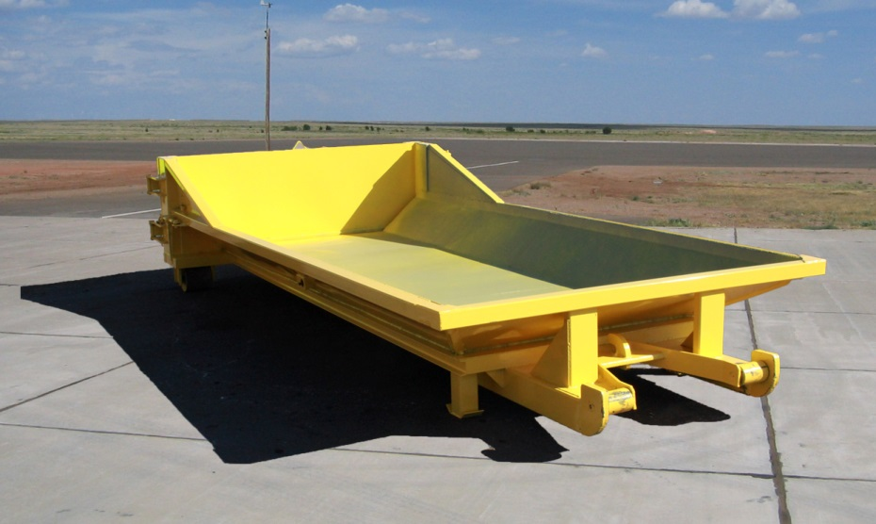
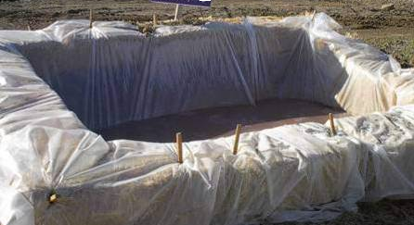
Concrete Truck Wash Out
Washing of concrete material into a street, catch basin, or other public facility or natural resource is prohibited.
A designated area for concrete washout shall be provided and clearly marked for usage.
Notes:
Paints, oils, fuel are other prohibited discharges

Slide 27
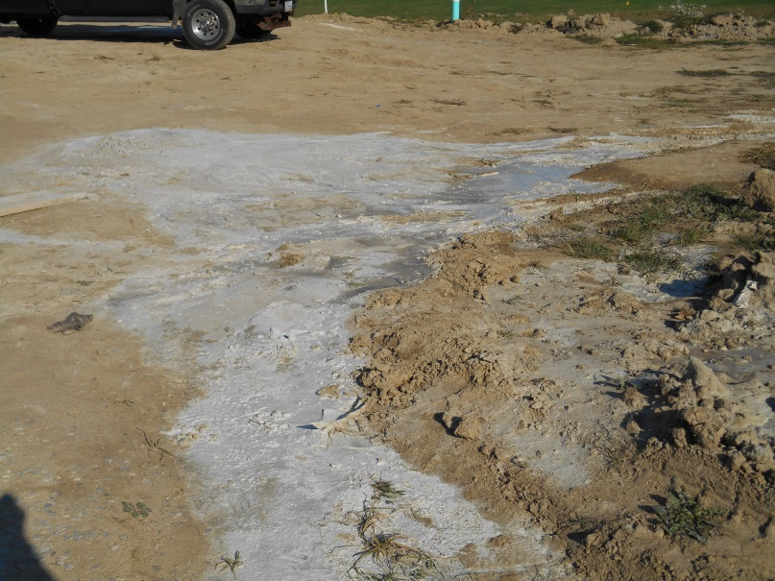
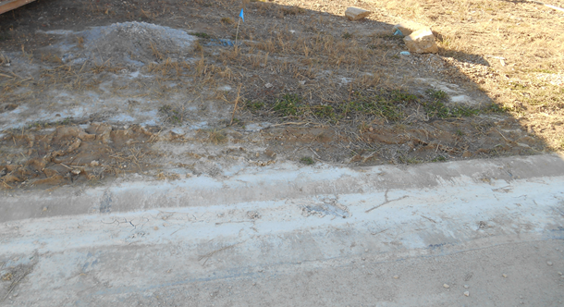
Concrete Truck Wash Out: Common Problems
Not using an approved method
Not using a wash out at all

Slide 28
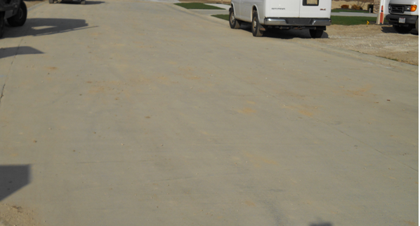
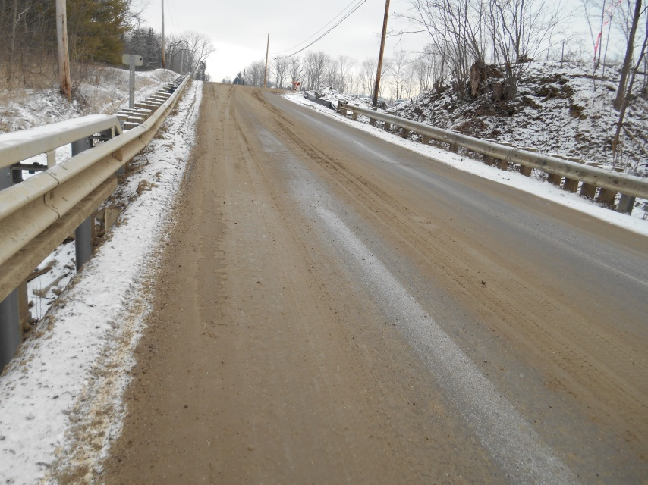
Street Sweeping
Not always needed
Streets directly adjacent to construction entrances and receiving traffic from the development area shall be cleaned daily to remove sediment tracked off-site.
If applicable, the catch basins on these streets nearest to the construction entrances shall be cleaned weekly.

Slide 29
Internal Inspection & Maintenance
All erosion and sediment controls must be inspected at least every seven days
  Within 24 hours after any storm event greater than one-half inch of rain per 24-hour period
  Inspection reveals a control is missing/needs maintenance:
  Must be repaired within 3 days of inspection
  Must be implemented within 10 days of inspection
  If practice is failing – plan must be amended & new control installed within 10 days
Notes:
Common problems – Controls are not inspected at all/ not maintained
Best time to inspect is after rainfall – see if it is failing

Slide 30
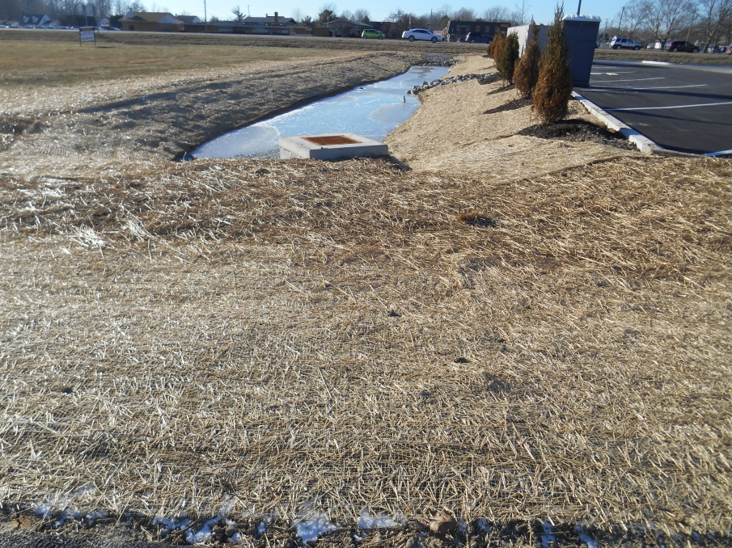
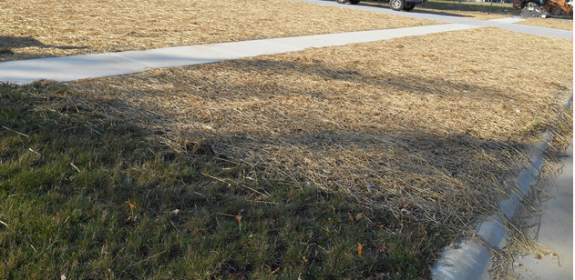
Temporary Stabilization
If disturbed soils are to remain idle 14 days to a year:
Must be stabilized within seven days of recent disturbance
Within 50 feet of a surface water of the state: stabilized within two days of recent disturbance
Soils to be idle over winter must be stabilized prior to November 1st
Notes:
Includes stock piles!!
Requirement may be waived if 30 feet of undisturbed vegetation exists along the perimeter, negating the need.

Slide 31
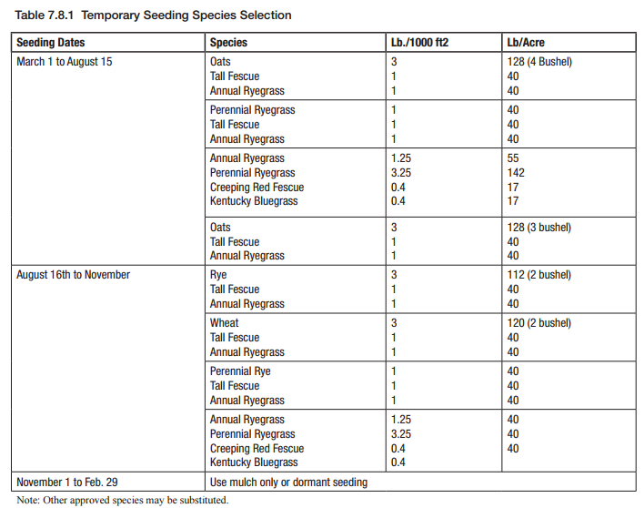
Temporary Stabilization
Applications of temporary seeding must include mulch (some exceptions)
Apply mulch during or immediately after seeding
Anchor mulch
Notes:
Winter months – straw mulch only
Seedings made during optimum seeding dates on favorable, very flat soil conditions may not need mulch to achieve adequate stabilization.
Anchor mulch with synthetic or natural netting materials, or mechanically with a disk/crimper

Slide 32
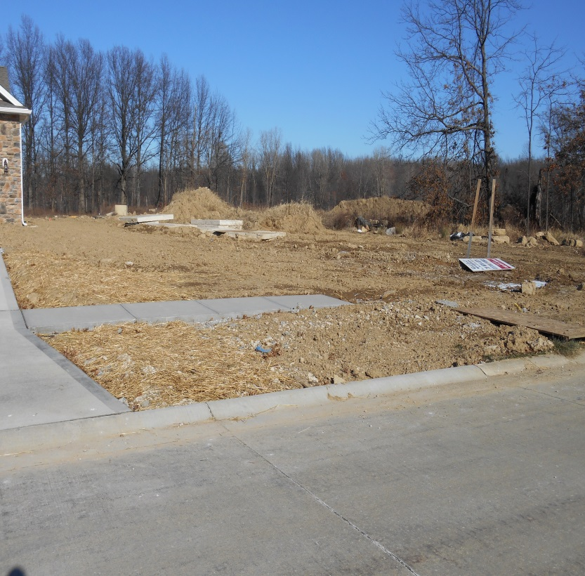
Temporary Stabilization
90% efficiency at erosion control when applied properly
Stabilize as you go
Common Problems:
Homeowners move in without stabilization laid
Patchy stabilization
Notes:
Straw should be laid liberally
If a portion of the perimeter – especially backyard – is not going to be touched for the remainder of construction, lay some straw and/or seeds.
Rule most violated
Inform homeowners of proper timeline

Slide 33
Temporary Stabilization
Responsibility of the original applicant to temporarily stabilize sites
Builders must temporarily stabilize prior to homeowner occupation
  Inform homeowners of proper stabilization timeline
Homeowner must permanently stabilized within 7 days of final grade
Notes:
Includes perimeter controls up and functioning. Cannot have sediment leaving site prior to homeowner occupation.
If sediment leaving site after homeowner moves in, still builders responsibility to correctly/successfully stabilize.

Slide 34
Permanent Stabilization
Disturbed soils must be permanently stabilized within seven days if:
At final grade
Idle for a year or more
Areas within 50 ft. of a watercourse (at final grade) must be permanently stabilized within two days
Usually installed by homeowner

Slide 35
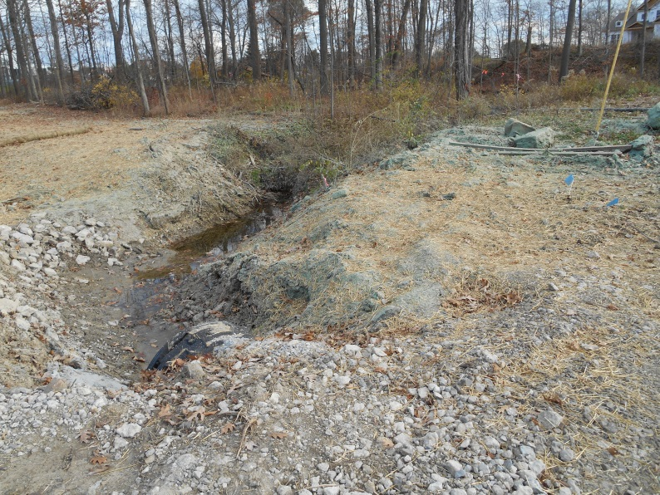
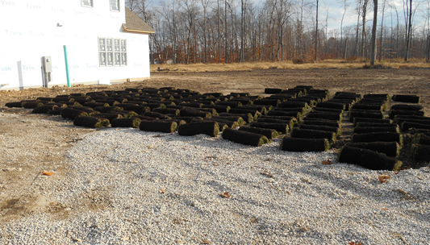
Permanent Stabilization
Methods include:
Sod
Seeding
Mulching (Straw, wood chips)
Hydroseeding
Notes:
Most efficient to lay straw over seeds – help retain moisture needed for germination

Slide 36
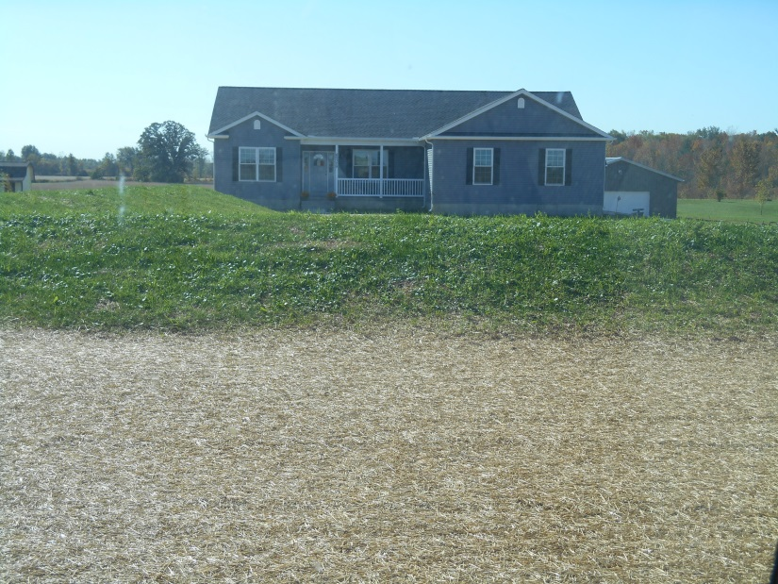
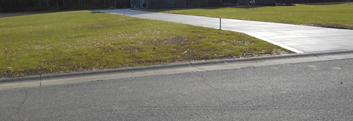
Stable vs. Complete
Stable:
No sediment leaving site
No erosion problems
Perimeter barriers/controls working
Complete:
Site has achieved 70% vegetative density
All controls removed
Notes:
Perimeter controls may not be removed until site is PERMANENTLY stabilized. Including inlet protection, SF, etc.
All parties on permit will be notified of site completion via “completion” report – states all obligations have been met.
Pause for questions

Slide 37
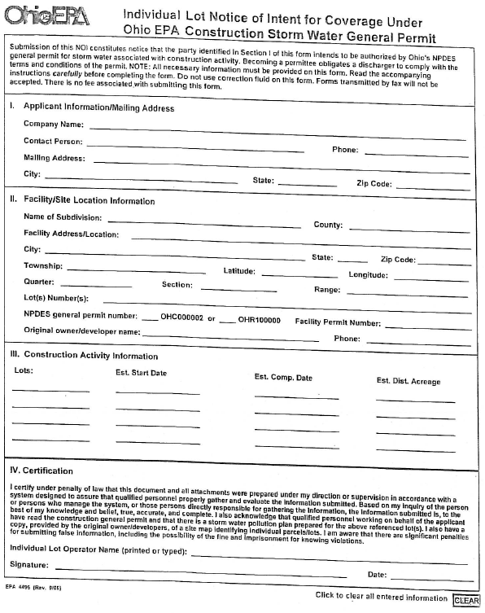
Erosion & Sediment Control Plans
Disturbances over 1 acre
Fee varies
Plan must be certified by professional engineer, surveyor, etc.
Submit Notice of Intent (NOI) to Ohio EPA
  Submit at least 21 days prior to start of construction
Notes:
Must submit fee, site map, application
Need npdes permit authorization letter

Slide 38
ESC Plans Must Include:
Non-structural Preservation Measures (phasing
construction, preserving existing vegetation, etc.)
Erosion Control Measures (seeding, mulching)
Runoff Control Practices (rock check dams,
diversions)
Sediment Control Practices (silt fence, inlet protection, sediment traps)
Non-sediment Pollutant Controls (concrete truck wash out, covered dumpster)
Compliance with other state/local regulations
Trench & Groundwater Control (Sediment settling/ de-watering devices)
Inspection & Maintenance Plans
Notes:
All must be shown on site map or detailed in plan descriptions
Check-list available at lorainswcd.com

Slide 39
ESC Plans: Site Maps
Should include:
Contours
Locations of ESC practices
Existing & Planned structures
Wetlands/surface waters
Limits of disturbance

Slide 40
ESC Plans
Pre-construction meetings:
Held a minimum of 7 days prior to soil disturbance
Involves developer, homeowner (if applicable), engineer, Administrator
Ensures ESC practices are properly installed prior to disturbances
Notes:
May be waived by administrator.
Useful for particularly sensitive sites

Slide 41
Common Management Practices
Sediment Basin:
Temporary settling pond
  Releases runoff at controlled rate
  Must be constructed & functional prior to upslope land disturbances
Notes:
For drainage area ≤ 100 acres
Locate them where least amount of earthwork needed – natural flow of drainage

Slide 42
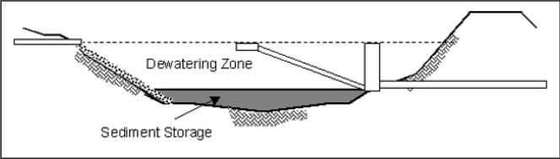
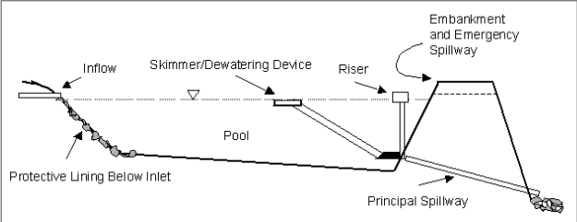
Sediment Basin
Consists of:
embankment
pool for water & sediment storage
principal & emergency spillway
controlled dewatering device
Notes:
Volume of Dewatering zone should be 1800 cubic ft per acre of drainage (67 yard³/acre)
Volume of sediment storage calculated by 2 methods:
1000 cubic ft. per disturbed acre within the watershed
Or
Calculated with RUSLE or similar accepted erosion prediction model (revised universal soil loss equation)
Length to width ratio: 4:1

Slide 43
Sediment Basin
Dewatering time for basins: minimum 48 hours; maximum 7 days
Common dewatering device: Skimmers
2 types: Faircloth & Delaware DOT
Notes:
The entire structure may be removed when construction is complete and the drainage area is stabilized or may be converted to a detention basin for post-construction storm water management.

Slide 44
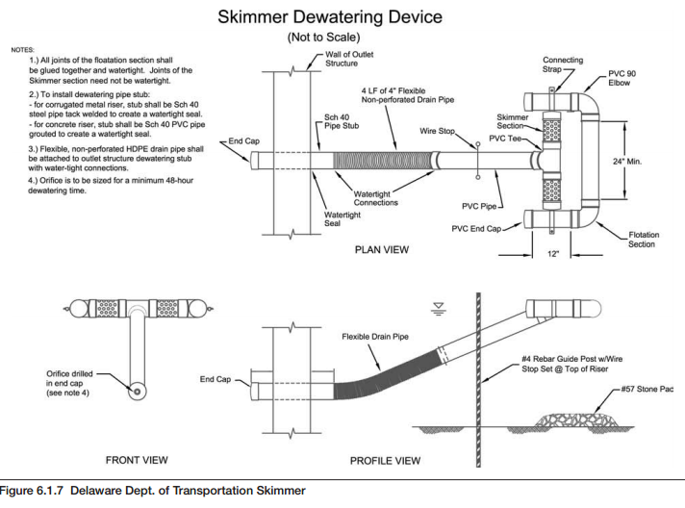
Sediment Basin
Delaware
DOT Skimmer
Notes:
The Delaware DOT skimmer has its orifice control located at the lowest portion of the device and therefore will not have a consistent head throughout the dewatering period. Thus two different design approaches must be used in sizing the orifices for each skimmer
The orifice shall be designed to remove the entire volume of the dewatering zone. The minimum dewatering time for the sediment basin is 48 hours

Slide 45
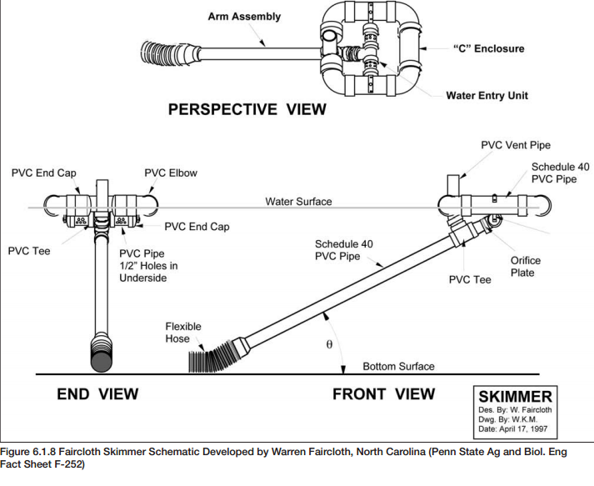
Sediment Basin
Faircloth Skimmer
Notes:
The “C” enclosure floats on the water surface and suspends the water entry unit just below the water surface.
Water discharge rate is to be controlled by an orifice located at the connection between the water entry unit and the arm assembly

Slide 46
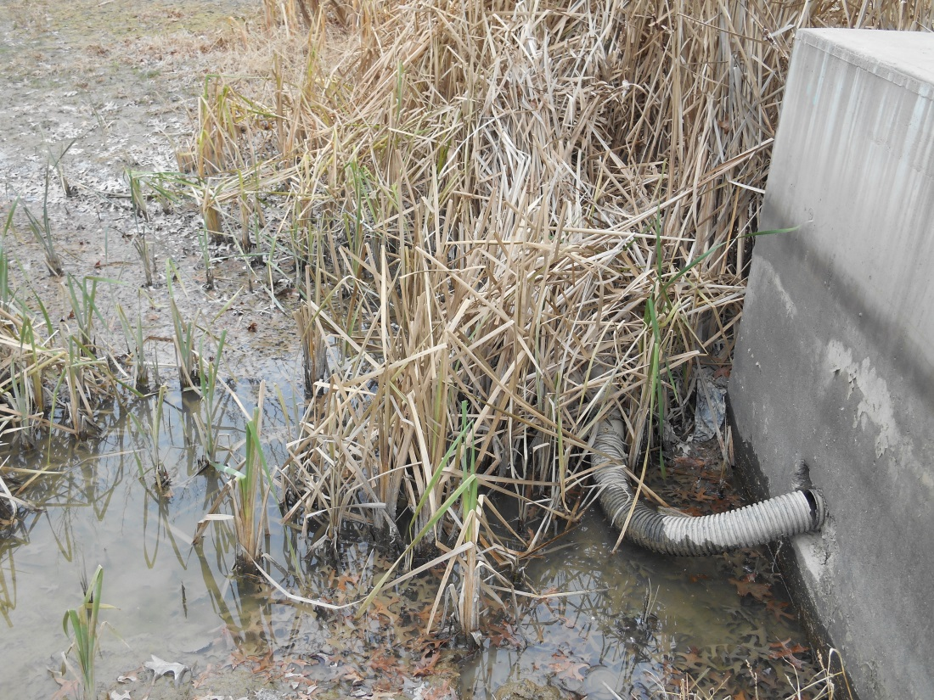
Skimmer Common Problems
Not attached
Removed prior to final stabilization
Not maintained

Slide 47
Comprehensive Storm Water Management Plan (CSWMP)/ SWPPP
Disturbances over 1 acre creating impervious surface (i.e. subdivisions)
Fee varies
NOI & NPDES permit authorization letter required
Includes same requirements as ESC plans
  Also requires Post Construction plan

Slide 48
CSWMP
Plan must be certified
Check-list available for SWPPPs
Pre-construction meeting
The approved plan shall be kept at the development site and made available to contractors, site managers, inspectors, and the administrator(s)
  Including maintenance inspection logs

Slide 49
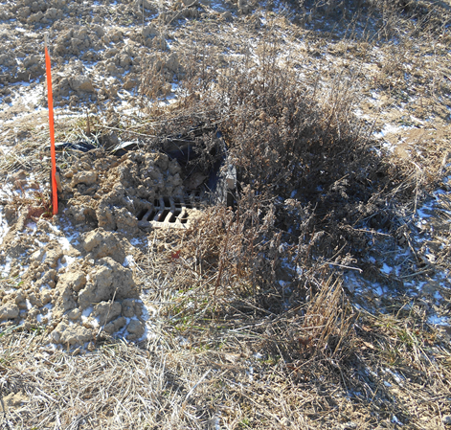
Violations
Inspections conducted every 30 days after permit approval
Common violations:
Sediment entering roadways
Sediment entering storm drains
Lack of erosion & sediment controls

Slide 50
Violations
If violation observed:
First Notice of Violation issued
30 days to address deficiencies
If same violation observed after 30 days:
Second Notice of Violation issued
15 days to address deficiencies
If problem(s) persists:
Stop Work Order
County prosecutor involvement
Civil fines
Notes:
Stop work order – after first obtaining the written approval of the prosecuting attorney of the county
- SWO site is inspected weekly

Slide 51
Helpful Communication
Builder-to-homeowner transfers
  Address changes
Corrections to violations
Notes:
Updates when you receive violations
Homeowner address changes to new home address
Updates when 2nd NOV are fixed

Slide 52
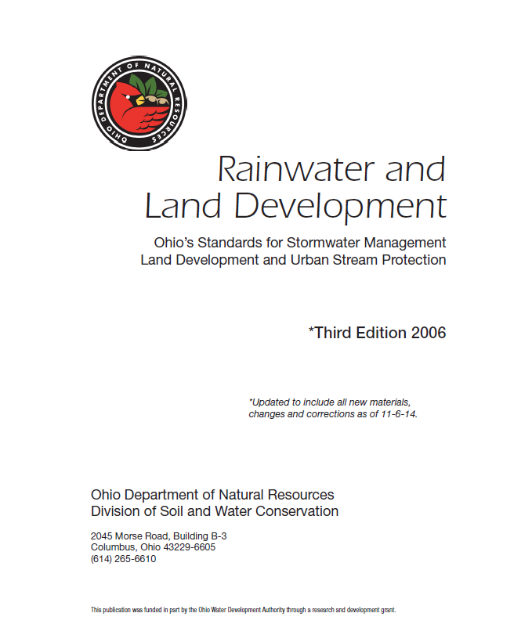
Resources
Specifications for erosion & sediment controls:
Ohio Department of Natural Resources (ODNR) Rainwater and Land Development Manual
ODNR Division of Water Resources → Water use & Planning → Stormwater Management

Slide 53

Resources
www.lorainswcd.com
  NPDES – Phase II tab
The Lorain County ESC Rules
Permit Application
SWPPP Check-list
ESC Plan Check-list
Helpful Guides

Slide 54

Resources
SWPPP Checklist

Slide 55
Resources
ccicerchi@loraincounty.us
440-326-5808
Office hours 8:00-4:30P.M., Monday-Friday
Best time to reach me: 8:00-10:00A.M.
Notes:
Reply to emails faster than voicemails
Always able to visit on site
Always in office 8am-9:30am+

Slide 56
Thank you!

Slide 57
Sources
http://charlottesierraclub.files.wordpress.com/2013/12/clean-water-act-will-work-for-clean-water.jpg
http://midwestconstruct.com/wp-content/uploads/2013/11/flexstorm.jpg
http://www.co.lake.ca.us/Assets/CDD/Stormwater+Mgt/Photos+for+Website/a++Concrete+Wash+out.jpg
http://hambickitrucks.com/wp-content/uploads/2012/09/washout.jpg

